Slide 1
Introduction to machine learning
Fabien Cellier

Slide 2
Plan
Reminder
Introduction
Learning Methods
K-means
DBSCAN
Decision Tree
Bayesian
Markov
SVM
Neural network
Optimisation
Gradient descent
Quasi newtonien (BLFGS)
Further

Slide 3
Reminder
Many type of data :
Vectors
Numeric
Category
Image
Audio
Speech
Music
Videos
Mix/Multiple ( tags/description of pictures)

Slide 4
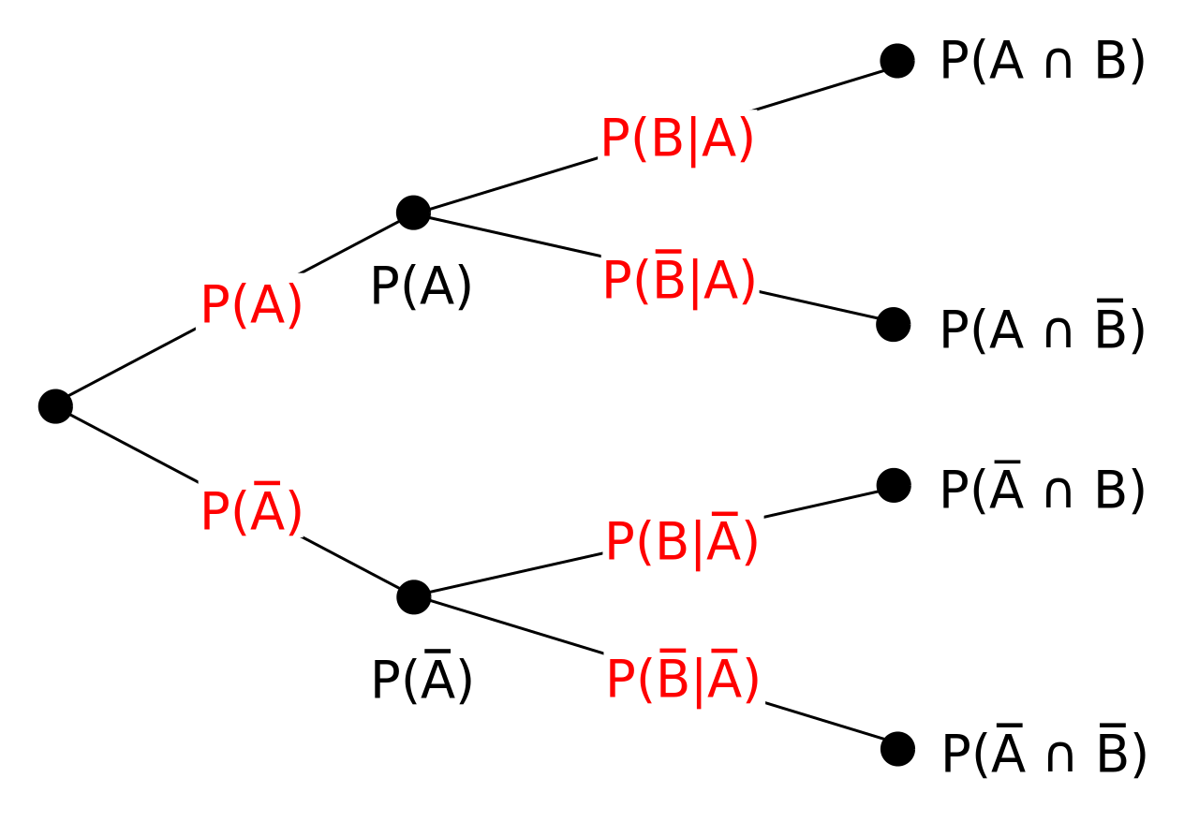
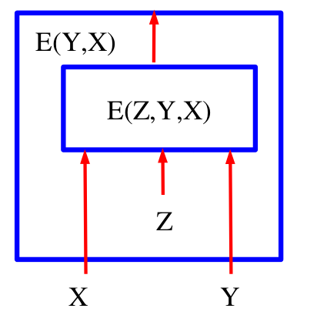
Reminder : Two visions for the learning (in general)
Probability (bias …)
Energy Based ( Geometry ):
minimisation of the model)

Slide 5
Reminder :
Last talk :
PCA
SVD
Distribution
Independence

Slide 6

How...

Slide 7
Introduction
Supervised :
Response is known
Classification : Categories,labels
Regression : Vectors
Unsupervised :
Response is unknown
Custlering : categories/labels
Dimensionality reduction : Vectors,compression

Slide 8
Introduction
Should know the existence of
Semi supervised learning: small quantity for supervised data and great quantity for unsupervised : try to mix supervised and unsupervised to improve the final result
Reinforcement learning: Find the best action to maximize the reward
Feature engineering : Transform the raw input data into new data to help the learning algorithm (fourier, convolution …)

Slide 9
Introduction
Online machine learning: when the data becomes available in a sequential order and is used to update our best predictor for future data at each step. (eg. gradient descent, also useful if the dataset is too big)
Machine-learned ranking: Find a way to score the relevance of an item (entry or vector)
Structured prediction: Structure the output (could be a graph, language sentences …)
Feature learning : Technique which try to find a feature from raw input to avoid the need of feature engineering ( eg. convnet)

Slide 10
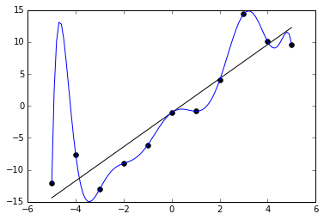
Introduction
Overfitting :
Complex model which fit to the train data set but can’t be used in real world (generalisation is not good) :

Slide 11
Introduction
Keep in mind :
Normalize the entry (min / max )
Normalize the distribution if possible (variance near 1)
Balance the data if possible
Use regularisation (L1,L2)
Check the validity of your model (cross validation)

Slide 12
Learning methods

Slide 13
Those methods are the bases, many evolutions exist

Slide 14
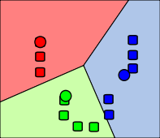
Learning Methods : k-means
Create K-cluster to segment input into sub-population with the similar properties/behaviors
Mathematically : minimize the distance between the sum of the distance between the center of the cluster and each point
* Image from Weston.pace

Slide 15
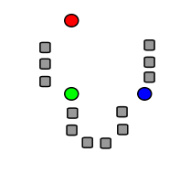
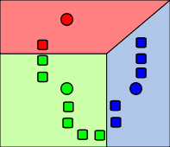
Learning Methods : k-means
Generally computation based on Lloyd's algorithm. For 2 dimensions
K points (random locations)

Slide 16
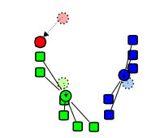
Learning Methods : k-means
Update the center for the k-cluster with the new barycenter
You can replace the means by another metric ( median for example)
You can use density function for the cluster ( Region growing )
Warning :
The problem for k-”cluster” is NP hard

Slide 17
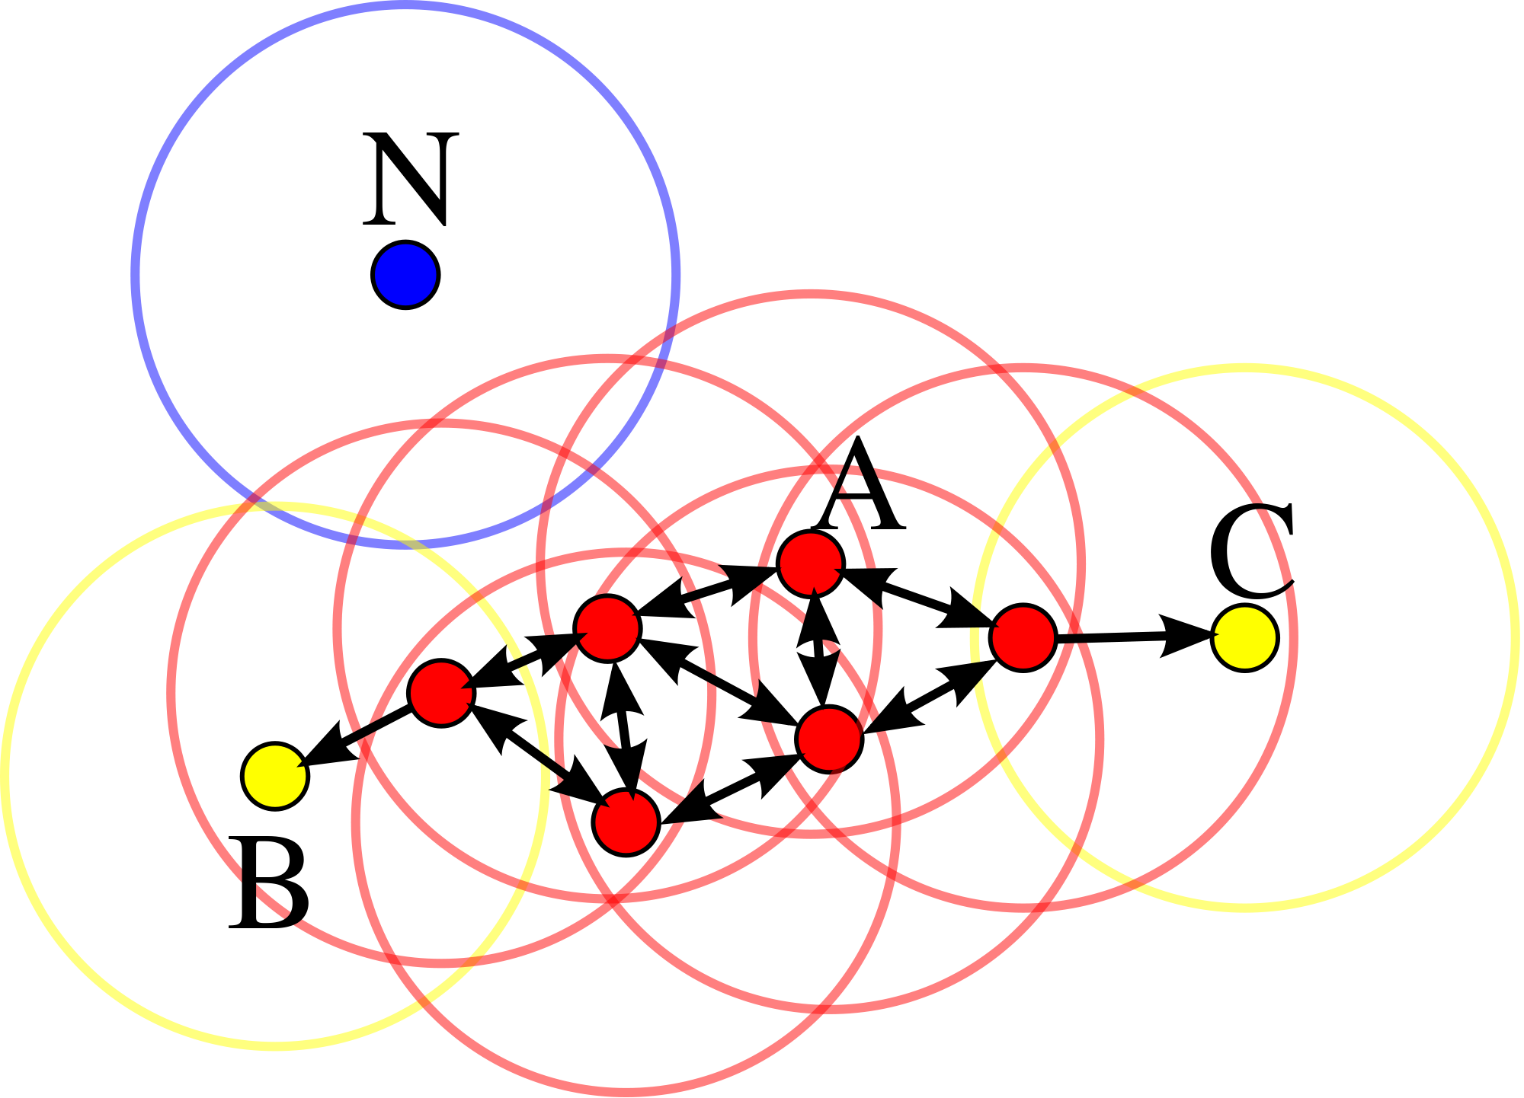
Learning Methods : DBSCAN
Find separation of the cluster from a maximum distance (allows to find outliers)

Slide 18
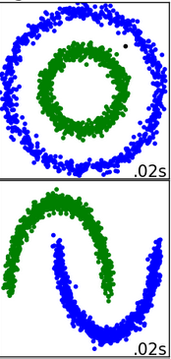
Learning Methods : DBSCAN
Could cluster when the k-means can’t
Don’t need to give the number of cluster

Slide 19
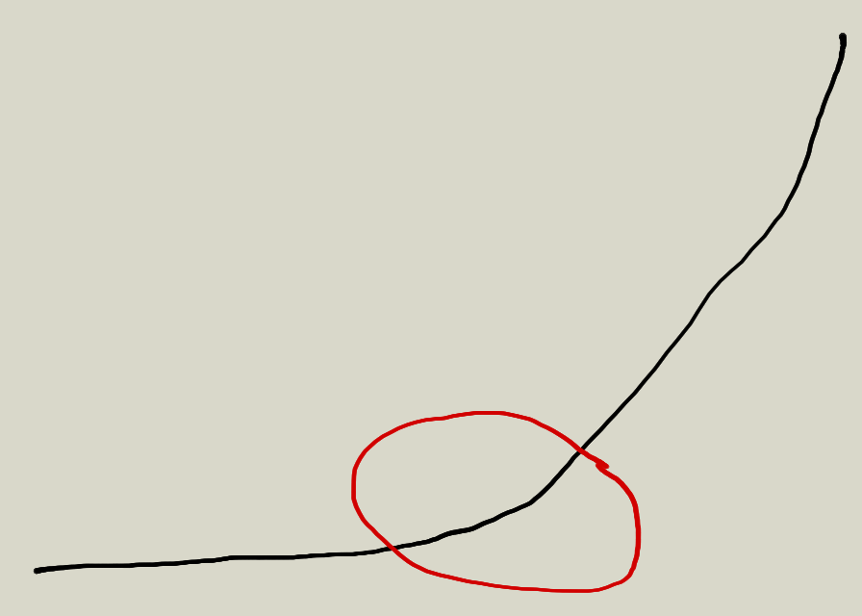
Learning Methods : Cluster
Divide your problem into smaller problem
First step to interpret your data (easy interpretation)
Number of cluster (for k-means for example), check the curve of the error :
Exercise :
Dbscan and k-median for the repartition of birthday from a population
X -> the month number, Y the day in the month

Slide 20

Until now, it was too easy

Slide 21
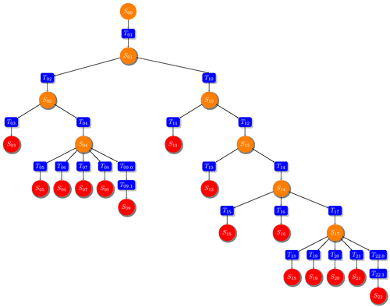
Learning Methods : Decision Tree

Slide 22
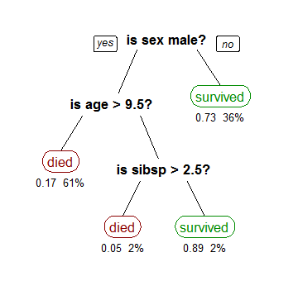
Learning Methods : Decision Tree

Slide 23
Learning Methods : Decision Tree
How to construct the right decision tree (best factor for decision):
Naive (difficult to apply with big data) : choose the variable which allow the best separation (that is to say the biggest bias in data)
Information Gain
based on information entropy
Be careful about overfitting
Gini ( sort the possible segment with the probability of bad result in the future if this criteria was chosen)

Slide 24
Learning Methods : Decision Tree
Advantages :
Easy to understand and explain
Easy to implement
Except for complicate criteria for segmentation, cheap computations
Can mix categorical and numerical data
Disadvantages :
Generalisation is not as good as other method
Prone to overfitting
Sometimes, large tree for simple problem ( parity in input for example)

Slide 25
Learning Methods : Bayesians statistics
Check the presence of a feature,value to infer the response
Exemple : naive Bayes classifiers
Hypothesis : There is no link between features (in our case : the words in the mail)
So all features should have a normal distribution!

Slide 26
Learning Methods : Bayesians statistics
 | Number of Word XXX | Number of Word YYY
Spam | 7 | 0
Spam | 5 | 2
Legit | 6 | 2
Spam | 10 | 1
Legit | 3 | 3
Legit | 2 | 1
??? | 4 | 1

Slide 27
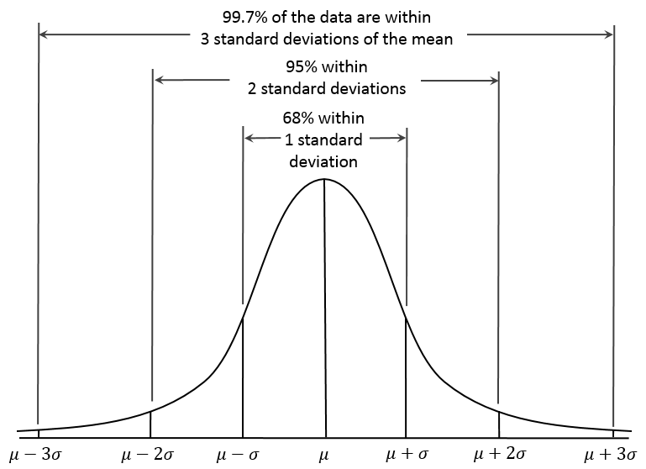
Learning Methods : Bayesians statistics
naive Bayes classifiers:
First step find the characteristics of the distribution

Slide 28
Learning Methods : Bayesians statistics
With the distribution you compute the probability associated to the sample:
P(XXX|spam) = (1/sqrt(2*pi*σ²)) * e^( (-(Nxxx-μ)²)/(2σ²) )
Post(spam) = P(Spam)*p(XXX|spam)*p(YYY|spam)
Post(non-spam) = P(non-spam)*p(XXX|non-spam)*p(YYY|non-spam)
If Post(spam)>Post(non-spam) then it’s a spam !!

Slide 29
Learning Methods : Bayesians statistics
Bayesian could be used with small quantity of data
Can be refined with time
Easy to understand and cheap computations ( again )

Slide 30
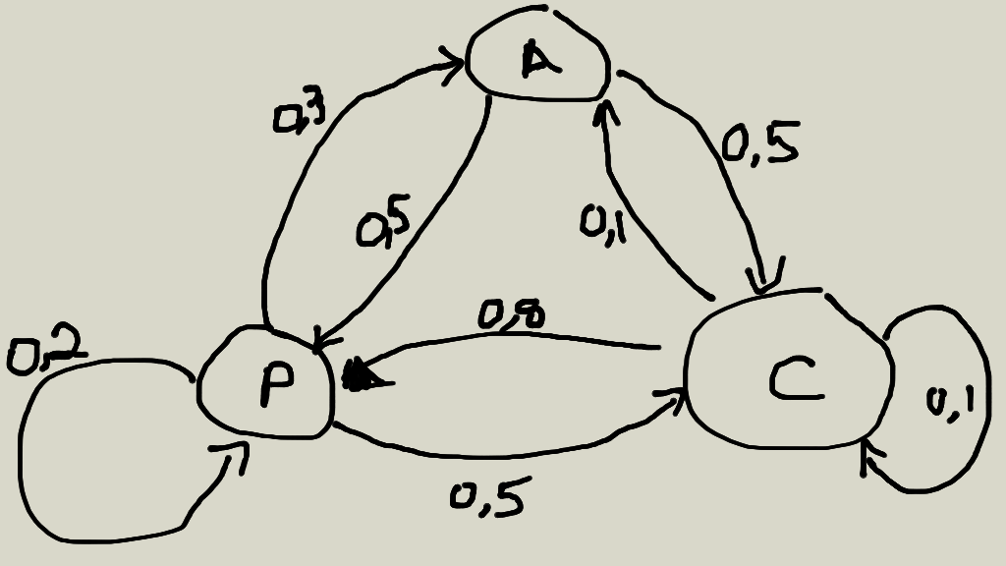
Learning Methods : Markov chains

Slide 31
Learning Methods : Markov chains
States could be defined from features (input)
Consider all informations are in states and no history interferes between states ( if you have historic to consider, add it in differents states)
With Big data : graph becomes too big and complex…
(generally approximate thanks to neural networks)

Slide 32
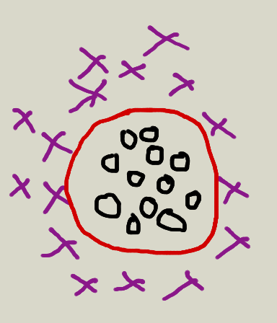
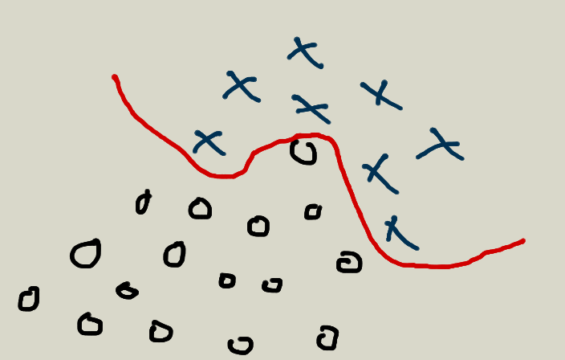
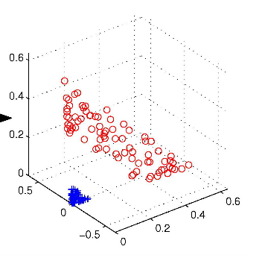
Learning Methods : Support Vector Machine
Suppose a linear separation exist…
… but it could exist in infinite dimension

Slide 33
Learning Methods : Support Vector Machine
Find linear separation with maximal margin in superior dimension (for example an hyperplan )
High dimension implies ... heavy computation!
To avoid too much calcul, generally the “kernel trick” is used

Slide 34
Learning Methods : Support Vector Machine
kernel trick: (Based on mercer’s theorem) You can replace the scalar product in the higher dimension( which contains the linear separation for the SVM), by a kernel in the original dimension.

Slide 35
Learning Methods : Neural Network
Slides from other presentation

Slide 36
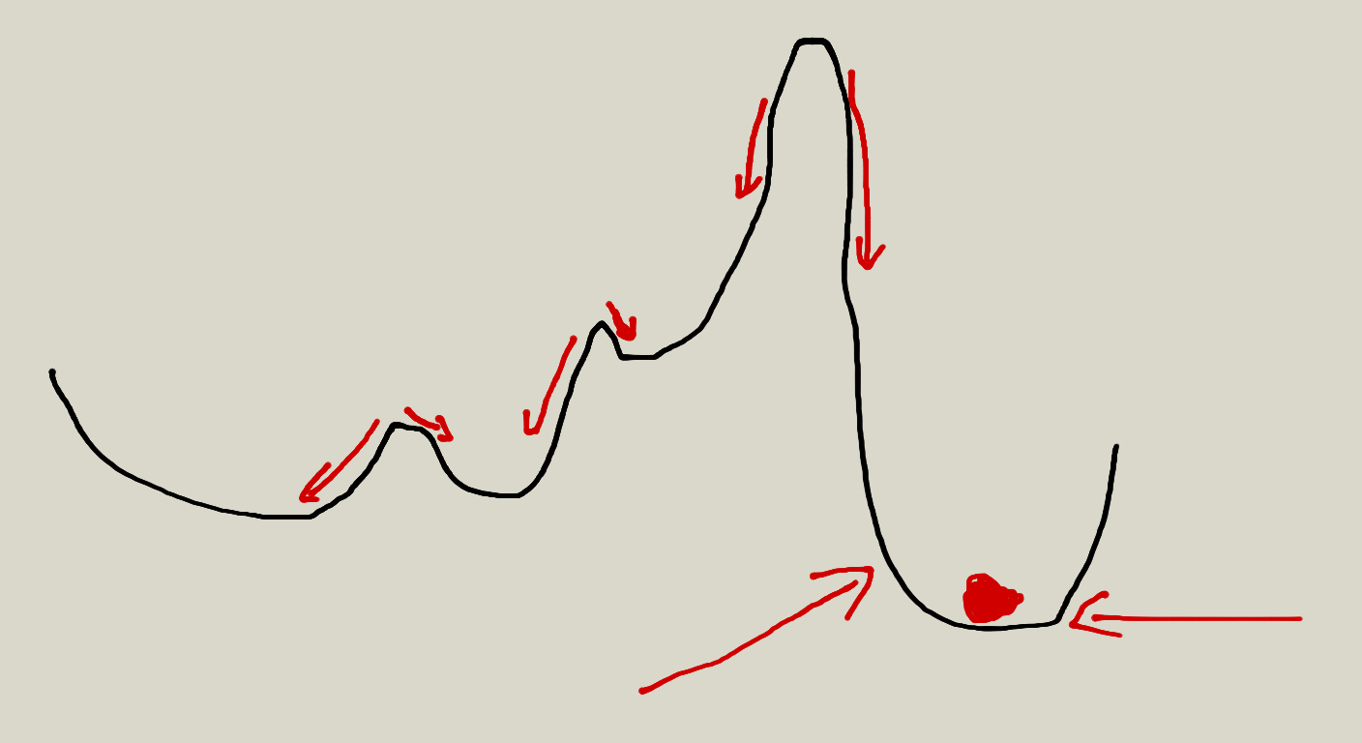
Optimisation : Gradient descent

Slide 37
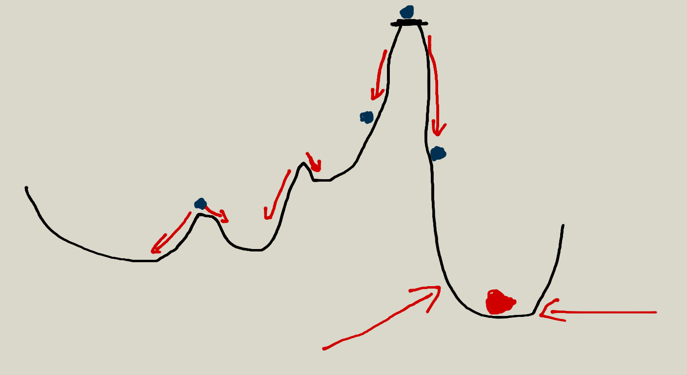
Optimisation : Gradient descent
TRY
MANY
POINTS
FOR
THE
START

Slide 38
Optimisation : L-BFSG
Limited-memory Broyden–Fletcher–Goldfarb–Shanno
Quasi newton method (Jacobian/Hessian): Quasi -> use approximation
Use Hessian to find minima/maxima
Better “direction” to find the minima than gradient descent (so fewer iteration), nevertheless each iteration is more expensive
Matrices could be more difficult/sparse to use than gradient descent on a graph

Slide 39
Further
Bagging : Separate the inputs into bags and each have its own model. Principle behind it: less information (entropy) so could focus on limited features
Boosting : Use an ensemble of weak classifier, most of times, small decisionTree which votes for the expected result ( AdaBoost, GradientBoost)
Stacking : Stack machine learning algorithms, output of the first algo as input of the second
Deep-Learning: Many layers directly in the machine learning process (convnet … )

Slide 40
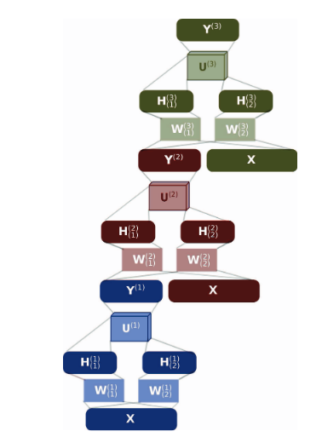
Conclusion
More than 15 Millions hyperparameters
And 8k neurons

Slide 41
Questions

Slide 42
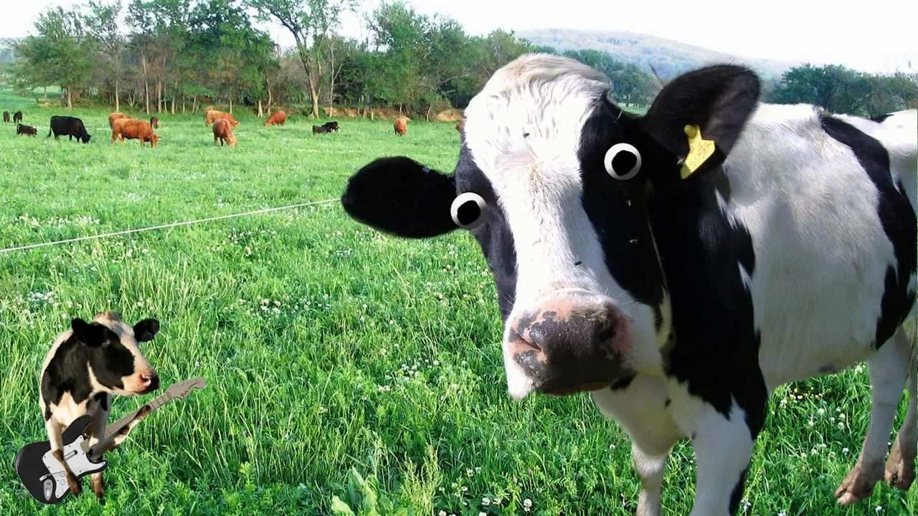

Slide 43
ANN for passionates guys
Hyperneat
Q-learning
MemN2N (gradient descent)

